Slide 1
GEN A I
GENERATIVE
ARTIFICIAL INTELLIGENCE
ARTIFICIAL:
NOT NATURAL THAT MEANS MADE BY HUMAN
INTELLIGENECE:
ABILITY TO THINK ,ANALYZE

Slide 2
AI BRANCHES
ML
DEEP LEARNING
NLP
EXPERT SYSTEM
FUZZY LOGIC
ROBOTICS
REINFORCEMENT LEARNING

Slide 3
What is Machine Learning ?
Past/present Data
Machine Learning Model
Predictions
Scientific Algorithms
It is a process of collecting past or present data to train a machine learning model using scientific algorithms so model can give us predictions/future outcomes .

Slide 4
NLP
Natural Language Processing (NLP) is a branch of Artificial Intelligence (AI) that enables computers to understand, interpret, analyze, and generate human language such as English, Hindi, Tamil, or any other language.
Examples:
ChatGPT
Google Translate
Siri and Alexa
Grammarly
NLP PIPELINE:
1.TEXT CLEANING
2.TOKENIZATION
3.STEMMING AND LEMATIZATION
4. BAG OF WORDS(BOW)
5.TF-IDF
6. WORD EMBEDDING

Slide 5
DRAWBACKS OF ML
ML can not generate
ML can not work with unstructured data like image, audio , it’s working required lots of feature engineering.

Slide 6
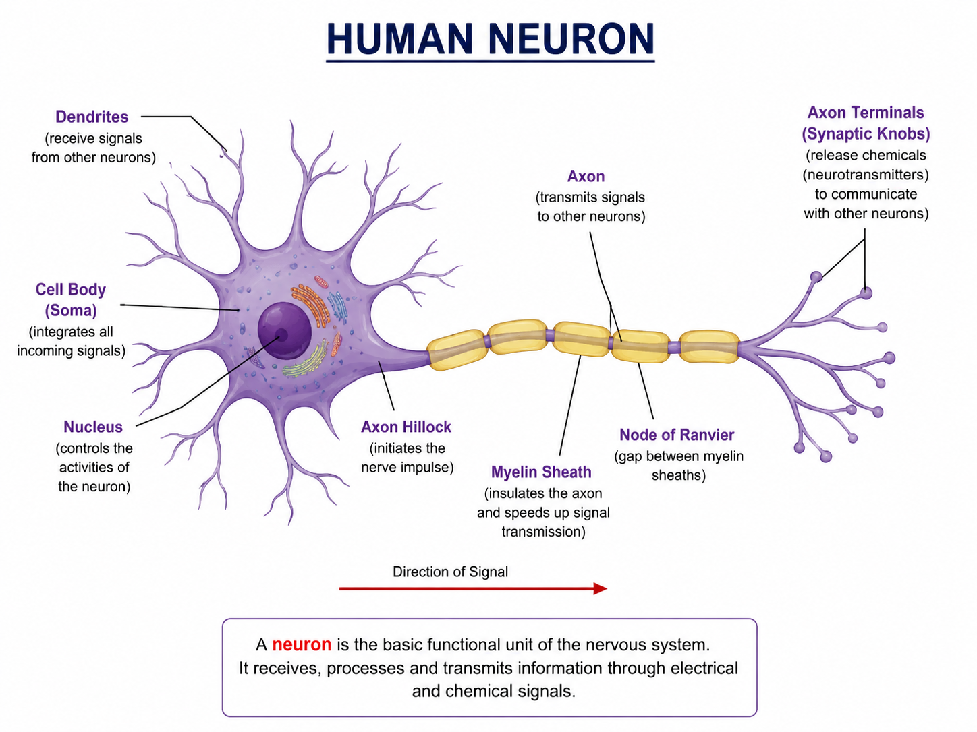
DEEP LEANING
IT’S ADVANCE SUBSET OF ML.
IT’ S USING NUERAL NETWORK ARCHITECTURE TO LEARN THE INFORMATION AND GENERATE OUTPUT.
HOW IT WORKS:

Slide 7
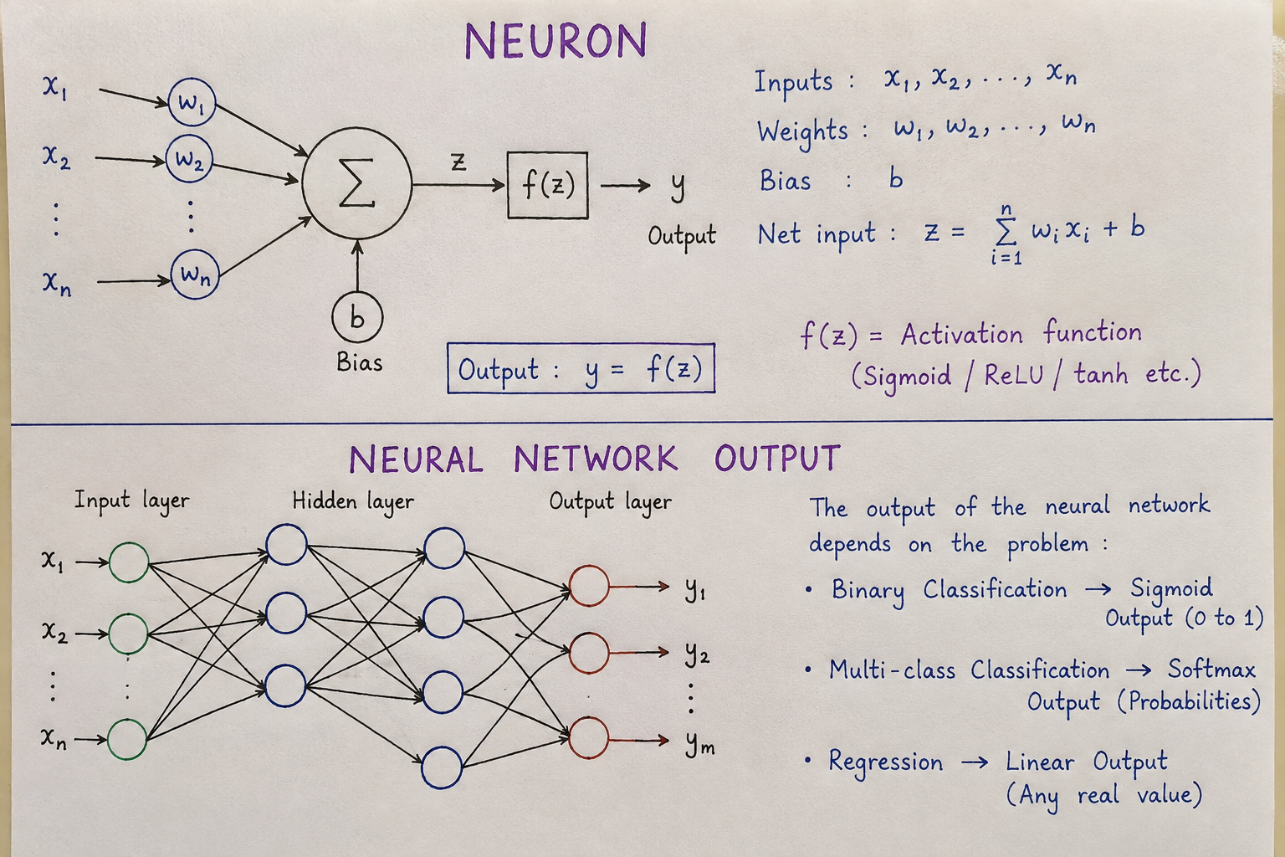
NUERAL TETWORK

Slide 8
TEXT CLEANING:
Remove unnecessary information from the text
Text cleaning is the process of converting raw, noisy text into a cleaner and more consistent form before giving it to an NLP model.
Common operations:
1.LOWERCASING
2.REMOVING PUNCTUATION
3.REMOVING NUMBERS
4.REMOVING STOPWORDS
5.REMOVING URL,EMAILS,MENTIONS,EMOJIS
Why is text cleaning needed?
Real-world text can contain:
"OMG!!! 😍 Check this PRODUCT!!! Visit https://abc.com
#BestProduct @company <br> It's soooo good!!!“

Slide 9
1.LOWERCASING:
Convert Text to Lowercase
Original:
"I LOVE Machine Learning"
Lowercase:
"i love machine learning"
Why?
Traditional ML models may treat:
"Apple"
"apple"
"APPLE"
as different tokens.
HOW?
BY WRITING PYTHON CODE:
text = "I LOVE Machine Learning"
text = text.lower()
print(text) "i love machine learning"

Slide 10
2.REMOVING HTML TAGS:
. Web pages often contain HTML.
Input
<p>I love this product</p>
Output
I love this product
Python:
from bs4 import BeautifulSoup
html = "<p>I love this product</p>"
text = BeautifulSoup(html, "html.parser").get_text()
print(text) I love this product

Slide 11
3. REMOVE URL
Example:
"Check this product at https://example.com"
After removing URL:
"Check this product at“
HOW?
Python:
import re
text = "Check this product at https://example.com“
text = re.sub(r"http\S+|www\S+", “ ", text)
print(text)
But should URLs always be removed?
No.
Suppose you're building a system that detects phishing URLs.
Then the URL is extremely important.
So cleaning depends on the NLP task.

Slide 12
4.REMOVING MENTION(@):
Social media text:
" This@movie is amazing!"
Possible cleaning:
"This movie is amazing!“
HOW TO DO?
Python:
original_text= " This@movie is amazing!"
new_text = original_text.replace(“@”,” ”)
But again, if the task is user/entity identification, the mention may be important.

Slide 13
5. Remove Punctuation
Example:
"Hello!!! How are you???"
Possible output:
“
HOW? "Hello How are you
Python:
import string
text = "Hello!!! How are you???"
text = text.translate(str.maketrans("“ "", string.punctuation))
print(text) Hello How are you
But be careful!
Punctuation can carry meaning.
For example:
"Great!"
"Great..."
"Great?"
They can express different emotions or intentions.
For sentiment analysis, punctuation may be useful.

Slide 14
6.Removing Numbers
Number removal means deleting numerical values from text when those numbers are not useful for the NLP task.
Example:
Original text:
"I bought 3 phones for ₹50000.“
After removing numbers:
"I bought phones for ₹.“
HOW?
Using Python: import re text = "I bought 3 phones for ₹50000." text = re.sub(r'\d+', ‘ ', text) print(text)

Slide 15
Removing Stopwords
Stopwords are very common words that often contribute little information to certain NLP tasks.
LIKE: the,is, are , am
Example
Original:
"The boy is playing in the park."
After removing stopwords:
"boy playing park“
How?
Using NLTK
import nltk
from nltk.corpus import stopwords
nltk.download('stopwords’)
stop_words = set(stopwords.words('english’))
text = "The boy is playing in the park.“
words = text.split()
filtered_words = [word for word in words if word.lower() not in stop_words]
print(filtered_words)
Output:
['boy', 'playing', 'park']

Slide 16
REMOVING EMAILS
Original
"Contact me at sam@example.com"
After removing email:
"Contact me at"
Python
import re
text = "Contact me at sam@example.com“
text = re.sub(r'\S+@\S+', ‘ ', text)
print(text)
Output:
Contact me at
Why remove emails?
Email addresses are often:
Personally identifying ,Unique to individual users ,Not useful for general text classification
For privacy-sensitive datasets, they are often removed or anonymized.

Slide 17
Removing Emojis
Example:
"This movie is amazing 😍❤️🔥"
After removing emojis:
"This movie is amazing"
Python
import emoji
text = "I love this product 😍❤️🔥“
clean_text = emoji.replace_emoji(text, replace=‘ ’)
print(clean_text)
⚠️ But emojis can carry meaning!
For sentiment analysis:
😍 → positive
❤️ → positive
😡 → negative
😢 → negative
So instead of removing emojis, we can convert them into text.

Slide 18
Tokenization
Tokenization is the process of breaking text into smaller units called tokens.
Think of tokenization as how you would split a sentence when you are reading — you naturally group letters into words, words into phrases. Tokenization teaches a computer to do the same thing.
WHY WE NEED THIS :
MODEL CAN NOT PROCESSD THE ALL TEXT AT ONCE, SO WE NEED TO SPLIT THEM IN TOKENS.
Simple Example
Input:
"I love Natural Language Processing."
After word tokenization:
["I", "love", "Natural", "Language", "Processing", "."]

Slide 19
TYPES OF TOKENIZATION
1. Sentence Tokenization:
Breaks a paragraph into sentences.
Example:
IMPLEMENTATION:
from nltk.tokenize import sent_tokenize
text = "I love NLP. NLP is interesting. I am learning NLP ."
print(sent_tokenize(text))
[
"I love NLP.",
"NLP is interesting.",
"I am learning NLP."
]

Slide 20
2. Word Tokenization
Breaks a sentence into individual words/tokens.
HOW?
from nltk.tokenize import word_tokenize
text = "I love NLP.“
print(word_tokenize(text))
["I", "love", "NLP"]

Slide 21
3. Character Tokenization
Breaks text into individual characters.
HOW?
text = "hello“
tokens = list(text)
print(tokens)
['h', 'e', 'l', 'l', 'o']

Slide 22
4. Subword Tokenization
Instead of treating every complete word as a token, a word can be divided into smaller meaningful pieces.
EXAMPLE:
WORD="unhappiness“ ["un", "happiness"]
Why use subwords?
Suppose the model knows:
play
playing
played
Player
Instead of storing every possible word separately, it can reuse common subword pieces.

Slide 23
BPE — Byte Pair Encoding
Start with small units and repeatedly merge the most frequent pair of units to create larger subword tokens. It helps a model handle both common words and rare/unseen words.
HOW IT WORKS?
Suppose our training data contains: low, lower, lowest
Initially, we can represent words as individual characters:
l o w l o w e r l o w e s t
BPE looks for frequently occurring adjacent pairs.
For example: l + o
If lo is a frequent pair, merge it: lo w lo w e r lo w e s t
Then perhaps:
lo + w is frequent.
Merge again: low low e r low e s t
The tokenizer has now learned: low er Est
So: lower → low + er lowest → low + est

Slide 24
Stemming:
Stemming is a text preprocessing technique that removes prefixes or suffixes from a word to obtain a shorter form called a stem.
Why do we need Stemming:
The boy is running.
The boy runs every morning.
The boy ran yesterday.
For a computer, these can initially be treated as different tokens:
running
runs
Ran
But semantically, they are related to the concept run.
What stemming will do?
playing → play
played → play
plays → play
But sometimes stemming produces an incorrect word:
studies → studi
ponies → poni
relational → relat

Slide 25
Stemming Algorithm:
1. Porter Stemmer:
Its purpose is to reduce words to a common stem by removing certain suffixes. For example:
caresses → caress
ponies → poni
ties → ti
cats → cat
If you notice:
ponies → poni
ties → ti
These are not necessarily valid English words.
That's because Porter Stemmer is concerned primarily with reducing words, not understanding their meaning

Slide 26
Lancaster Stemmer
Lancaster Stemmer is a rule-based stemming algorithm used in Natural Language Processing (NLP) to reduce words to their root or stem form.
The main characteristic of Lancaster Stemmer is that it is very aggressive compared with algorithms such as Porter Stemmer.
For example:
running → run
studies → study
maximum → maxim
Lancaster Stemmer takes a word and repeatedly applies a collection of suffix-removal.
Disadvantages of Lancaster Stemmer:
1. Over-stemming
2. Can produce unnatural stems: The output may not be a valid dictionary word.

Slide 27
Snowball Stemmer:
It is often considered an improvement/generalization of the original Porter stemming algorithm and supports multiple languages.
For example:
connected
connecting
connection
Connections
can be reduced toward: connect

Slide 28
Lemmatization:
Lemmatization is an NLP preprocessing technique that converts a word into its base or dictionary form, called its lemma.
Unlike stemming, lemmatization tries to make sure the resulting word is a valid meaningful word.
Simple example:
running → run
runs → run
ran → run
studies → study
children → child
mice → mouse
better → good
How it covert:
In NLTK WordNet lemmatization, you'll commonly see:
Tag | Meaning | Example
n | Noun | cats
v | Verb | running
a | Adjective | better
r | Adverb | quickly

Slide 29
Text Representation —
Making Text Understandable to Machines
Machines cannot process raw text — they need numbers. Text Representation techniques convert words and sentences into numerical vectors that machine learning models can work with. This is the bridge between language and mathematics.
Bag of Words (BoW):
Definition: Bag of Words is the simplest text representation method. It represents a document as an unordered collection (bag) of words, ignoring grammar and word order, and counting how often each word appears.
📌 BoW Example
Document 1: 'the cat sat on the mat'
Document 2: 'the dog sat on the log'
Vocabulary: {the, cat, sat, on, mat, dog, log}
BoW Vector for Doc 1: [2, 1, 1, 1, 1, 0, 0]
BoW Vector for Doc 2: [2, 0, 1, 1, 0, 1, 1]
⚠️ Problem: BoW loses word order. 'Dog bites man' and 'Man bites dog' get the same vector!

Slide 30
TF-IDF(Term Frequency – Inverse Document Frequency):
It is a technique used in NLP (Natural Language Processing) to convert text into numerical vectors and determine how important a word is in a document.
Why do we use TF-IDF?
Suppose we have:
Document 1: "I love machine learning"
Document 2: "I love deep learning"
Document 3: "machine learning is powerful"
The word "learning" appears in almost every document, so it is not very useful for distinguishing documents.
The word "powerful" appears only once, so it is more informative.
TF-IDF gives:
High score → word is important/specific to a document
Low score → word is common across many documents

Slide 31
TF — Term Frequency
TF tells us how frequently a word occurs in a document.
Formula:
TF(t,d)=Total number of terms in document d/Number of times term t appears in document d​
IDF — Inverse Document Frequency:
IDF tells us how rare or unique a word is across all documents.
Formula: IDF(t)=log(N/DF(t))
Where:
N = total number of documents
DF(t) = number of documents containing the term

Slide 32
Example:
Suppose we have 3 documents:
Document 1: apple banana apple
Document 2: banana orange banana
Document 3: apple mango

Slide 33
Step 1: Vocabulary
All unique words are:
Apple Banana Orange mango
Step 2: Term Frequency (TF):
Step 3: Document Frequency:
Word | D1 | D2 | D3
apple | 2/3 = 0.667 | 0 | 1/2 = 0.5
banana | 1/3 = 0.333 | 2/3 = 0.667 | 0
orange | 0 | 1/3 = 0.333 | 0
mango | 0 | 0 | 1/2 = 0.5
Word | Documents containing word | DF
apple | D1, D3 | 2
banana | D1, D2 | 2
orange | D2 | 1
mango | D3 | 1

Slide 34
Step 4: Calculate IDF
Apple: IDF(apple)=log(3/2​)=0.405
Banana IDF(banana)=log(3/2​)=0.405
Orange IDF(orange)=log(3/1​)=1.099
Mango IDF(mango)=log(3/1​)=1.099
Notice that orange and mango have higher IDF because they occur in only one document.
Step 5: Calculate TF-IDF:
Formula:: TF−IDF=TF×IDF
For D1: apple : 0.667×0.405=0.270 , banana: 0.333×0.405=0.135 , orange: 0*1.099=0, mango: 0*1.099=0
For D2: banana: 0.667×0.405=0.270, orange: 0.333×1.099=0.366, apple: 0, mango: 0
For D3: apple: 0.5×0.405=0.203 , mango: 0.5×1.099=0.549, banana: 0, orange: 0
What can we understand?
Look at D3: D3 = apple mango:
Even though both occur once, mango gets a much higher score because mango occurs in only one document, while apple occurs in two.

Slide 35
Drawbacks of TF-IDF
1. ❌ Doesn't understand meaning:
TF-IDF only looks at word frequency, not the meaning of words.
Example:
"I like cars"
"I like automobiles“
TF-IDF considers cars and automobiles as completely different features. It doesn't know that they have similar meanings.
2.. ❌ Ignores word order:
3. ❌ Creates sparse vectors:
Suppose your vocabulary contains 10,000 words.
Each document may become a vector like: [0, 0, 0, 0, 0, 0, 0, 0, 1.2, 0, ...]

Slide 36
Word Embedding:
Words with similar meanings should have similar vector representations.
For example:
king → [0.72, 0.41, 0.89, ...]
queen → [0.69, 0.44, 0.91, ...]
apple → [0.12, 0.83, 0.21, ...]
car → [0.45, 0.17, 0.76, ...]
Why do we need Word Embeddings?
Computers don't understand words like: cat Dog King queen directly
We need to convert them into numbers.
But if we apply One-hot encoding:
cat → [1, 0, 0, 0]
dog → [0, 1, 0, 0]
king → [0, 0, 1, 0]
car → [0, 0, 0, 1]
The computer doesn't know that cats and dogs are semantically related.

Slide 37

Types of Word Embeddings
1. Word2Vec: Developed by Google.
It learns word vectors by looking at surrounding words.
Two approaches:: CBOW Skip-gram
CBOW(Continuous Bag of Words):
Predicts the target word from surrounding words.
Example: :”Hope can set you free”
Suppose our window size = 3 (at a time how many words to consider) and target = can, context(input)=Hope, set
i/p 3 nodes in hidden layer compare and updates the weight
W 3*5
Hope actual target
Set W 3*5 predicted one hot vector of can
1
0
0
0
0
0
0
1
0
0

Slide 38
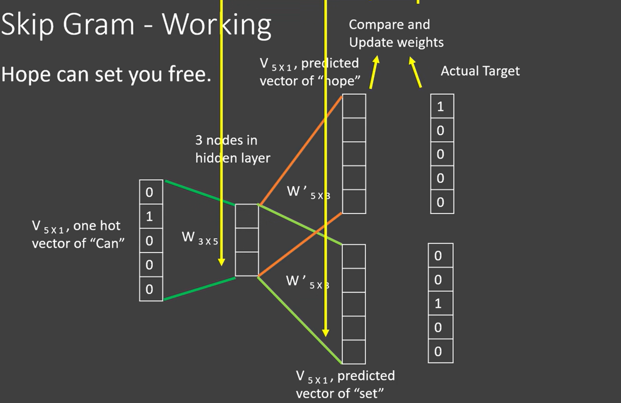
Skip Gram:
Instead of using context to predict the target, we use the target word to predict surrounding words.

Slide 39
